Slide 1
Mining the World-Wide Web
The WWW is huge, widely distributed, global information service centre for
  Information services: news, advertisements, consumer information, financial management, education, government, e-commerce, etc.
  Hyper-link information
  Access and usage information
WWW provides rich sources for data mining
Challenges
  Too huge for effective data warehousing and data mining
  Too complex and heterogeneous: no standards and structure
Babu Ram Dawadi

Slide 2
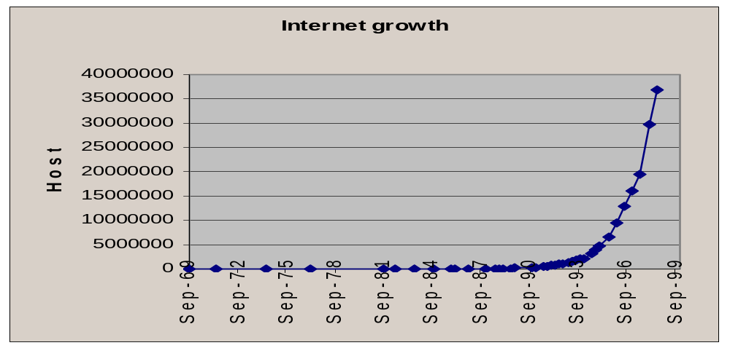
Mining the World-Wide Web
Growing and changing very rapidly
Broad diversity of user communities
Only a small portion of the information on the Web is truly relevant or useful
  99% of the Web information is useless to 99% of Web users
  How can we find high-quality Web pages on a specified topic?
Babu Ram Dawadi

Slide 3
Web search engines
Index-based: search the Web, index Web pages, and build and store huge keyword-based indices
Help locate sets of Web pages containing certain keywords
Deficiencies
  A topic of any breadth may easily contain hundreds of thousands of documents
Babu Ram Dawadi

Slide 4
Web Mining Taxonomy
Web Mining
Web Content
Mining
Web Structure
Mining
Web Usage
Mining
Web Page
Content Mining
Search Result
Mining
General Access
Pattern Tracking
Customized
Usage Tracking
Babu Ram Dawadi

Slide 5
Mining the World-Wide Web
Web Mining
Web Content
Mining
Web Structure
Mining
Web Usage
Mining
Web Page Content Mining
Web Page Summarization
WebLog
Web Structuring query languages;
Can identify information within given web pages
Ahoy! Uses heuristics to distinguish personal home pages from other web pages
ShopBot: Looks for product prices within web pages
Search Result
Mining
General Access
Pattern Tracking
Customized
Usage Tracking
Babu Ram Dawadi

Slide 6
Mining the World-Wide Web
Web Mining
Web Content
Mining
Web Structure
Mining
Web Usage
Mining
Web Page
Content Mining
Search Result Mining
Search Engine Result Summarization
Clustering Search Result Categorizes documents using phrases in titles and snippets
General Access
Pattern Tracking
Customized
Usage Tracking
Babu Ram Dawadi

Slide 7
Mining the World-Wide Web
Web Mining
Web Content
Mining
Web Usage
Mining
Web Structure Mining
Using Links
PageRank (Brin et al., 1998)
CLEVER (Chakrabarti et al., 1998)
Use interconnections between web pages to give weight to pages.
Using Generalization
Uses a multi-level database representation of the Web. Counters (popularity) and link lists are used for capturing structure.
Search Result
Mining
General Access
Pattern Tracking
Web Page
Content Mining
Customized
Usage Tracking
Babu Ram Dawadi

Slide 8
Mining the World-Wide Web
Web Mining
Web Content
Mining
Web Structure
Mining
Web Usage
Mining
Web Page
Content Mining
General Access Pattern Tracking
Web Log Mining
Uses KDD techniques to understand general access patterns and trends.
Can shed light on better structure and grouping of resource providers.
Customized
Usage Tracking
Search Result
Mining
Babu Ram Dawadi

Slide 9
Mining the World-Wide Web
Web Mining
Web Content
Mining
Web Structure
Mining
Web Usage
Mining
Web Page
Content Mining
General Access
Pattern Tracking
Customized Usage Tracking
Adaptive Sites
Analyzes access patterns of each user at a time.
Web site restructures itself automatically by learning from user access patterns.
Search Result
Mining
Babu Ram Dawadi

Slide 10







Multiple Layered Web Architecture
More Generalized Descriptions
Layer_{n}
...
Generalized Descriptions
Layer₁
Layer₀
Babu Ram Dawadi

Slide 11
Mining the World-Wide Web
Layer-0: Primitive data
Layer-1: dozen database relations representing types of objects (metadata)
document, organization, person, software, game, map, image,…
document(file_addr, authors, title, publication, publication_date, abstract, language, table_of_contents, category_description, keywords, index, multimedia_attached, num_pages, format, first_paragraphs, size_doc, timestamp, access_frequency, links_out,...)
person(last_name, first_name, home_page_addr, position, picture_attached, phone, e-mail, office_address, education, research_interests, publications, size_of_home_page, timestamp, access_frequency, ...)
image(image_addr, author, title, publication_date, category_description, keywords, size, width, height, duration, format, parent_pages, colour_histogram, Colour_layout, Texture_layout, Movement_vector, localisation_vector, timestamp, access_frequency, ...)
Babu Ram Dawadi

Slide 12
Mining the World-Wide Web
Layer-2: simplification of layer-1
doc_brief(file_addr, authors, title, publication, publication_date, abstract, language, category_description, key_words, major_index, num_pages, format, size_doc, access_frequency, links_out)
person_brief (last_name, first_name, publications,affiliation, e-mail, research_interests, size_home_page, access_frequency)
Layer-3: generalization of layer-2
cs_doc(file_addr, authors, title, publication, publication_date, abstract, language, category_description, keywords, num_pages, form, size_doc, links_out)
doc_summary(affiliation, field, publication_year, count, first_author_list, file_addr_list)
doc_author_brief(file_addr, authors, affiliation, title, publication, pub_date, category_description, keywords, num_pages, format, size_doc, links_out)
person_summary(affiliation, research_interest, year, num_publications, count)
Babu Ram Dawadi

Slide 13
Web Usage Mining
Mining Web log records to discover user access patterns of Web pages
Applications
  Target potential customers for electronic commerce
  Enhance the quality and delivery of Internet information services to the end user
  Improve Web server system performance
  Identify potential prime advertisement locations
Web logs provide rich information about Web dynamics
  Typical Web log entry includes the URL requested, the IP address from which the request originated, and a timestamp
Babu Ram Dawadi

Slide 14
Techniques for Web usage mining
Construct multidimensional view on the Weblog database
  Perform multidimensional OLAP analysis to find the top N users, top N accessed Web pages, most frequently accessed time periods, etc.
Perform data mining on Weblog records
  Find association patterns, sequential patterns, and trends of Web accessing
  May need additional information,e.g., user browsing sequences of the Web pages in the Web server buffer
Conduct studies to
  Analyze system performance, improve system design by Web caching, Web page prefetching, and Web page swapping
Babu Ram Dawadi

Slide 15
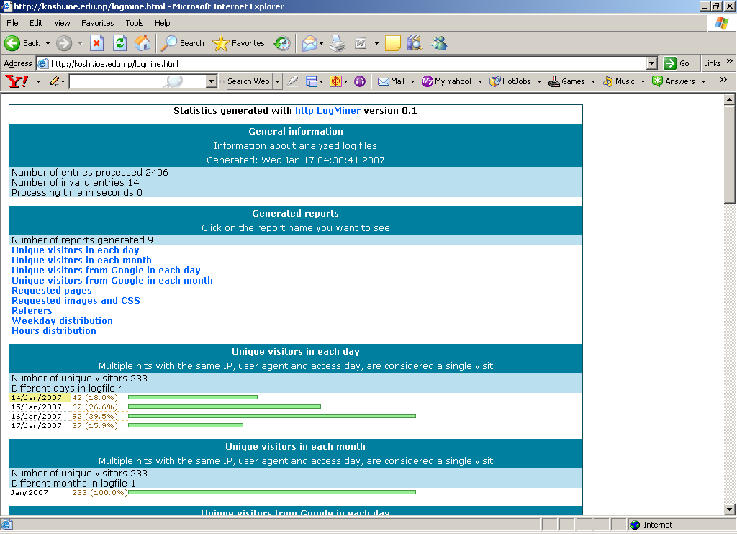
Babu Ram Dawadi

Slide 16




Mining the World-Wide Web
Design of a Web Log Miner
  Web log is filtered to generate a relational database
  A data cube is generated form database
  OLAP is used to drill-down and roll-up in the cube
  OLAM is used for mining interesting knowledge
Knowledge
Web log
Database
Data Cube
Sliced and diced
cube
1
Data Cleaning
2
Data Cube
Creation
3
OLAP
4
Data Mining
Babu Ram Dawadi

Slide 17
What is Customer Relationship Management?
MORE than a technology
  A philosophy .. a strategy … a discipline for handling information and designing business processes
For CRM to be truly effective,
  an organization must first understand who its customers are and what their value is over a lifetime.
  The company must then determine what the needs of its customers are and how best to meet those needs.
  Next, the organization must look into all of the different ways information about customers comes into a business, where and how this data is stored and how it is currently used.”
CRM “brings together lots of pieces of information about customers, sales, marketing effectiveness, responsiveness and market trends” (“What is CRM”)
Babu Ram Dawadi

Slide 18
Relationship Marketing
Relationship Marketing is a Process
  communicating with your customers
  listening to their responses
Companies take actions
  marketing campaigns
  new products
  new channels
  new packaging
Babu Ram Dawadi

Slide 19
The Move Towards Relationship Management
E-commerce companies want to customize the user experience
Credit card companies want to recommend good restaurants and hotels in new cities
Phone companies want to know your friends and family
Bottom line: Companies want to be in the business of serving customers rather than merely selling products
Babu Ram Dawadi

Slide 20
CRM is Revolutionary
Banks have been in the business of managing the spread between money borrowed and money lent
Insurance companies have been in the business of managing loss ratios
Telecoms have been in the business of completing telephone calls
Key point: More companies are beginning to view customers as their primary asset
Babu Ram Dawadi

Slide 21
The Electronic Trail
A customer places a catalog order over the telephone
At the local telephone company
  time of call, number dialed, long distance company used, …
At the long distance company (for the toll-free number)
  duration of call, route through switching system, …
At the catalog
  items ordered, call center, promotion response, credit card used, inventory update, shipping method requested, …
Babu Ram Dawadi

Slide 22
The Electronic Trail-- continued
At the credit card clearing house
  transaction date, amount charged, approval code, vendor number, …
At the bank
  billing record, interest rate, available credit update, …
At the package carrier
  zip code, time stamp at truck, time stamp, …
Bottom line: Companies do keep track of data
Babu Ram Dawadi

Slide 23
CRM Requires Learning and More
Form a learning relationship with your customers
  Notice their needs
    On-line Transaction Processing Systems
  Remember their preferences
    Decision Support Data Warehouse
  Learn how to serve them better
    Data Mining
  Act to make customers more profitable
Babu Ram Dawadi

Slide 24
The Importance of Channels
Channels are the way a company interfaces with its customers
Examples
  Direct mail
  Email
  Banner ads
  Telemarketing
  Billing inserts
  Customer service centers
  Messages on receipts
Key data about customers come from channels
Babu Ram Dawadi

Slide 25




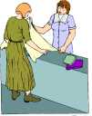


Why is a single view of the customer hard to achieve?? E.g., Retailing/direct sales
Online shopping
Order, inventory, shipment information
Phone orders
Retail sales
E-Mail/ Mail Orders
Customer information (360 view)
Call centers, customer support
Babu Ram Dawadi

Slide 26
Goals of CRM
Typical CRM goals:
  Acquire customers (direct marketing, identifying)
  Retain customers (customer service contacts)
  Enhance revenue from customers (profiling, customization)
Track/analyze customer needs; profiling
  Data warehousing, analytic software
Increasing revenues/profits by marketing -- ‘everyone is in sales’
Monitor sales, better planning
Babu Ram Dawadi

Slide 27
Technologies that underlie CRM applications
Many technologies can contribute to CRM applications, depending on the area of focus
  Most are basic ICTs that need to be integrated, e.g.,
Data collection
Data storage/maintenance (e.g., customer data bases, data warehouses or marts)
Data analysis/interpretation (e.g., data mining and analytic software)
Data presentation (e.g., web-based portals, mobile devices)
Workflow/process automation software packages
Newer technologies relate to web-based and mobile communication channels
Babu Ram Dawadi

Slide 28
Channels
Channels are the source of data
Channels are the interface to customers
Channels enable a company to get a particular message to a particular customer
Channel management is a challenge in organizations
CRM is about serving customers through all channels
Babu Ram Dawadi

Slide 29
Where Does Data Mining Fit In?
Hindsight
Analysis and
Reporting (OLAP)
Foresight
Insight
Statistical
Modeling
Data
Mining
Babu Ram Dawadi

Slide 30
What is a Customer
A transaction?
An account?
An individual?
A household?
The customer as a transaction
  purchases made with cash are anonymous
  most Web surfing is anonymous
  we, therefore, know little about the consumer
Babu Ram Dawadi

Slide 31
A Customer is an Account
More often, a customer is an account
Retail banking
  checking account, mortgage, auto loan, …
Telecommunications
  long distance, local, ISP, mobile, …
Insurance
  auto policy, homeowners, life insurance, …
Babu Ram Dawadi

Slide 32
Customers Play Different Roles
Parents buy back-to-school clothes for teenage children
  children decide what to purchase
  parents pay for the clothes
  parents “own” the transaction
Parents give college-age children cellular phones or credit cards
  parents may make the purchase decision
  children use the product
It is not always easy to identify the customer
Babu Ram Dawadi

Slide 33
The Customer’s Lifecycle
Childhood
  birth, school, graduation, …
Young Adulthood
  choose career, move away from parents, …
Family Life
  marriage, buy house, children, divorce, …
Retirement
  sell home, travel, hobbies, …
Much marketing effort is directed at each stage of life
Babu Ram Dawadi

Slide 34
The Customer’s Lifecycle is Unpredictable
It is difficult to identify the appropriate events
  graduation, retirement may be easy
  marriage, parenthood are not so easy
  many events are “one-time”
Companies miss or lose track of valuable information
  a woman gets married, changes her last name, and merges her accounts with spouse
It is hard to track your customers so closely, but, to the extent that you can, many marketing opportunities arise
Babu Ram Dawadi

Slide 35
Customers Evolve Over Time
Customers begin as prospects
Prospects indicate interest
  fill out credit card applications
  apply for insurance
  visit your website
They become new customers
After repeated purchases or usage, they become established customers
Eventually, they become former customers
  either voluntarily or involuntarily
Babu Ram Dawadi

Slide 36
Business Processes Organize Around the Customer Lifecycle
Acquisition
Activation
Relationship Management
Former
Customer
High
Value
Prospect
New
Customer
Established
Customer
Voluntary
work
High
Potential
Low
Value
Forced
work
Babu Ram Dawadi

Slide 37
Different Events Occur Throughout the Lifecycle
Prospects receive marketing messages
When they respond, they become new customers
They make initial purchases
They become established customers and are targeted by cross-sell and up-sell campaigns
Some customers are forced to leave (cancel)
Some leave (cancel) voluntarily
Others simply stop using the product
Babu Ram Dawadi

Slide 38
Privacy is a Serious Matter
Data mining and CRM raise some privacy concerns
These concerns relate to the collection of data, more than the analysis of data
The next few slides illustrate marketing mistakes that can result from the abundance and availability of data
Babu Ram Dawadi

Slide 39
The Story of Former Senior Chief
Petty Officer Timothy McVeigh
Several years ago, Timothy used an AOL account, with an anonymous alias
Under marital status, he listed “gay”
A colleague discovered the account and called AOL to verify that the owner was Timothy
AOL gave out the information over the phone
Timothy was discharged (three years short of his pension)
Babu Ram Dawadi

Slide 40
Serious Privacy Violations
AOL breached its own policy by giving out confidential user information
  AOL paid an undisclosed sum to settle with Timothy and suffered bad press as well
  Timothy received an honorable discharge with full retirement pension
Babu Ram Dawadi

Slide 41
Friends, Family, and Others
In the 1990s, MCI promoted the “Friends and Family” program
They asked existing customers for names of people they talked with often
If these friends and family signed up with MCI, then calls to them would be discounted
Early in 1999, BT (formerly British Telecom) took the idea one step beyond
BT invented a new marketing program
  discounts to the most frequently called numbers
Babu Ram Dawadi

Slide 42
BT Marketing Program
BT notified prospective customers of this program by sending them their most frequently called numbers
One woman received the letter
  uncovered her husband’s cheating
  threw him out of the house
  sued for divorce
The husband threatened to sue BT for violating his privacy
BT suffered negative publicity
Babu Ram Dawadi

Slide 43
No Substitute for Human Intelligence
Data mining is a tool to achieve goals
The goal is better service to customers
Only people know what to predict
Only people can make sense of rules
Only people can make sense of visualizations
Only people know what is reasonable, legal, tasteful
Human decision makers are critical to the data mining process
Babu Ram Dawadi

Slide 44
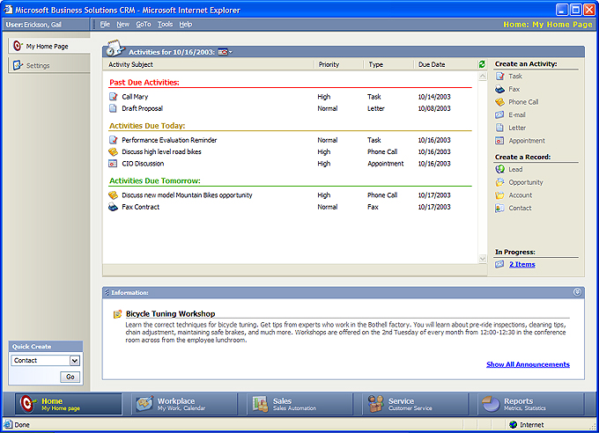
Microsoft CRM Dynamics http://www.microsoft.com/BusinessSolutions/content/demos/MSCRMdemos/full_demo.htm
Babu Ram Dawadi

Slide 45
Privacy & Security Aspects
Privacy-Preserving Data Mining
How do we mine data when we can’t even look at it?
Individual Privacy
  Nobody should know more about any entity after the data mining than they did before
Organization Privacy
  Protect knowledge about a collection of entities
    Individual entity values may be known to all parties
    Which entities are at which site may be secret
Babu Ram Dawadi

Slide 46
Privacy constraints don’t prevent data mining
Goal of data mining is summary results
  Association rules
  Classifiers
  Clusters
The results alone need not violate privacy
  Contain no individually identifiable values
  Reflect overall results, not individual organizations
The problem is computing the results without access to the data!
Babu Ram Dawadi

Slide 47
Example: Privacy of Distributed Data
Data
Mining
Combiner
Combined
valid
results
What
Won’t
Work
What Will
Work
The Data
Warehouse
Approach
Data
Mining
Warehouse
Local
Data
Mining
Local
Data
Mining
Local
Data
Mining
Local
Data
Local
Data
Local
Data
Babu Ram Dawadi
Notes:
Local data mining distributes control over data mining!
Cognos corp. is advertising “distributed data mining” -- the model they are using is build a central warehouse.

Slide 48
Privacy-Preserving Data Mining: Who?
Government / public agencies. Example:
  The Centers for Disease Control want to identify disease outbreaks
  Insurance companies have data on disease incidents, seriousness, patient background, etc.
  But can/should they release this information?
Industry Collaborations / Trade Groups. Example:
  An industry trade group may want to identify best practices to help members
  But some practices are trade secrets
  How do we provide “commodity” results to all (Manufacturing using chemical supplies from supplier X have high failure rates), while still preserving secrets (manufacturing process Y gives low failure rates)?
Babu Ram Dawadi

Slide 49
Privacy-Preserving Data Mining: Who?
Multinational Corporations
  A company would like to mine its data for globally valid results
  But national laws may prevent transborder data sharing
Public use of private data
  Data mining enables research studies of large populations
  But these populations are reluctant to release personal information
Babu Ram Dawadi

Slide 50
Data Mining as a Threat to Security
Data mining gives us “facts” that are not obvious to human analysts of the data
Enables inspection and analysis of huge amounts of data
Possible threats:
  Predict information about classified work from correlation with unclassified work (e.g. budgets, staffing)
  Detect “hidden” information based on “conspicuous” lack of information
  Mining “Open Source” data to determine predictive events (e.g., Pizza deliveries to the Pentagon)
It isn’t the data we want to protect, but correlations among data items
Babu Ram Dawadi
Notes:
Problem is that we may not know what may be learned from mining
Can’t “Classify everything”; as some is open source or may have large benefits to being accessible
This is the opposite of statistical queries – we are concerned about preventing generalities from specifics, rather then specifics from generalities – but conceptually similar.
Not the same as induction – data mining finds “rules” that are generally true (high confidence and support), but not necessarily exact.

